Slide 1

Game AI using Machine Learning
P Sivakishore
18-May-2020

Slide 2
Who Am I ?
I‘m a Bluetooth verification Programmer for Client Intel.
Ex-Game Developer (Real Cricket)
Worked in Gameloft, Nautilus Mobile
Console Gameplayer

Slide 3
Agenda
Develop an AI that plays Tetris game by itself

Slide 4
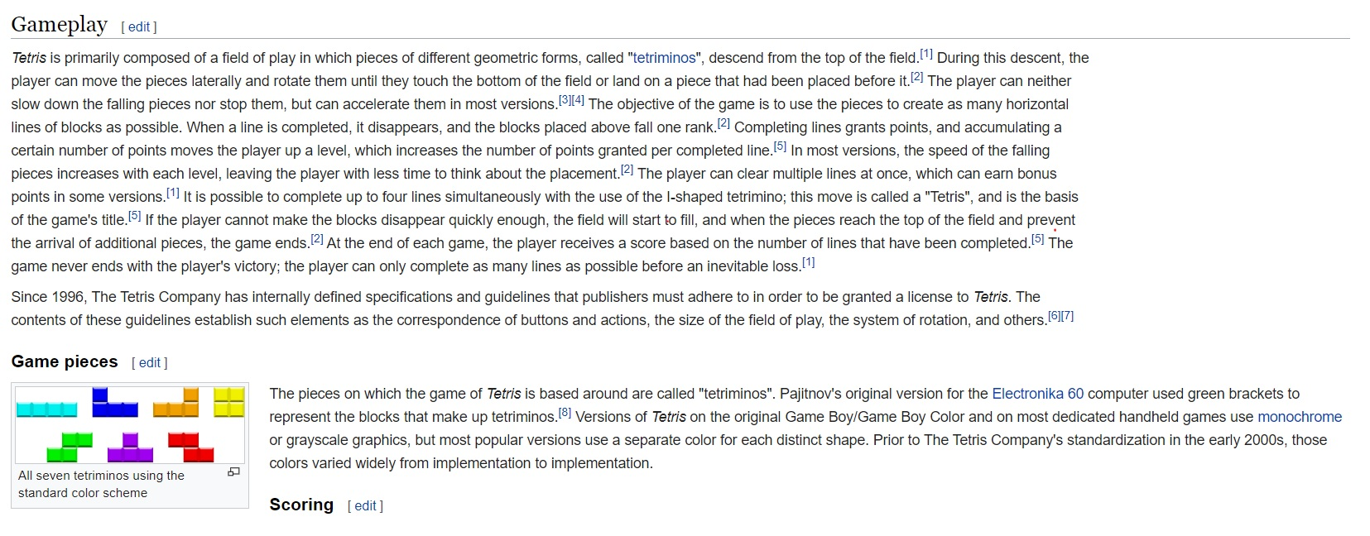
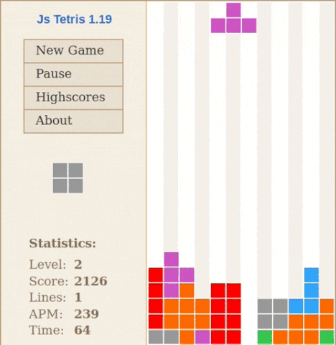
Tetris Introduction
Wikipedia

Slide 5
Best Ways to create a AI in Games
Handcrafted Code
Using Game Theory
Symmetric / Asymmetric
Zero-sum/ Non-Zero-Sum
MinMax
Simultaneous / Sequential
Tetris is a state based game, generally for state based games we use MinMax algorithms
Let’s understand MinMax

Slide 6
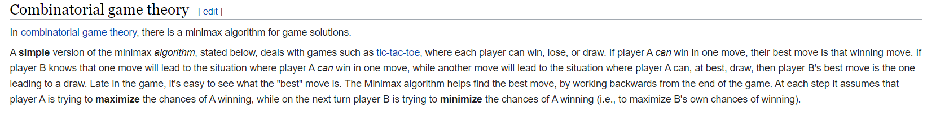
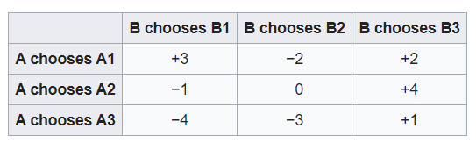
MinMax
6

Slide 7
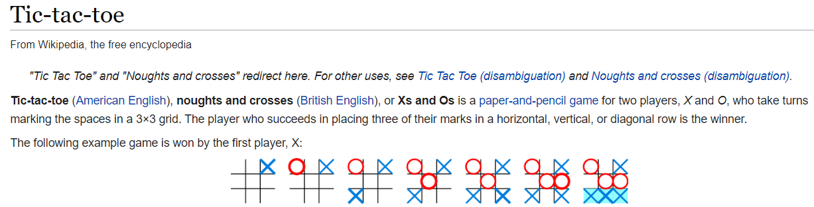
MinMax Example

Slide 8
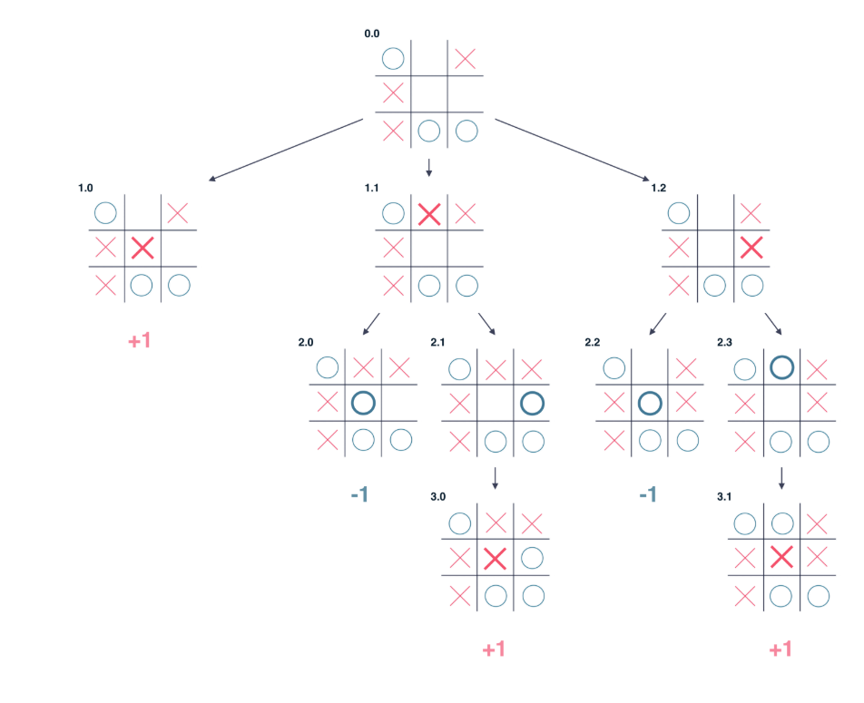
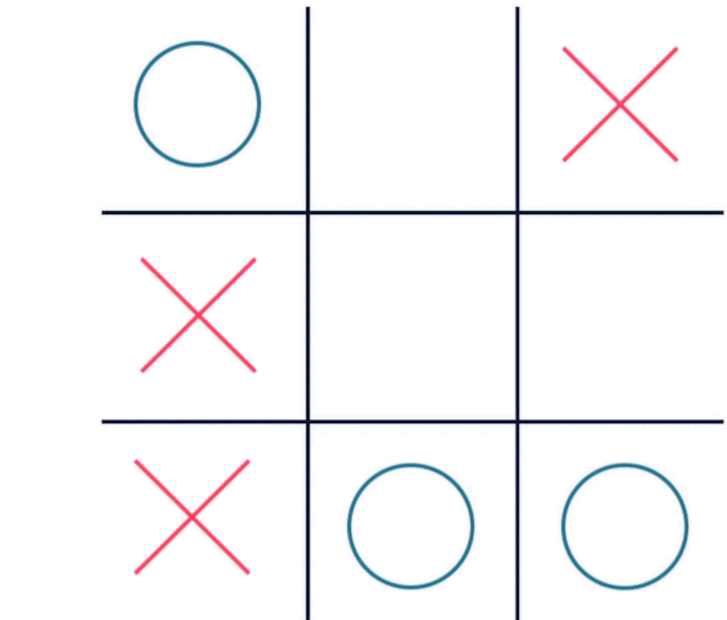
MinMax Example cont..
Consider Below Tic Tac Toe State

Slide 9
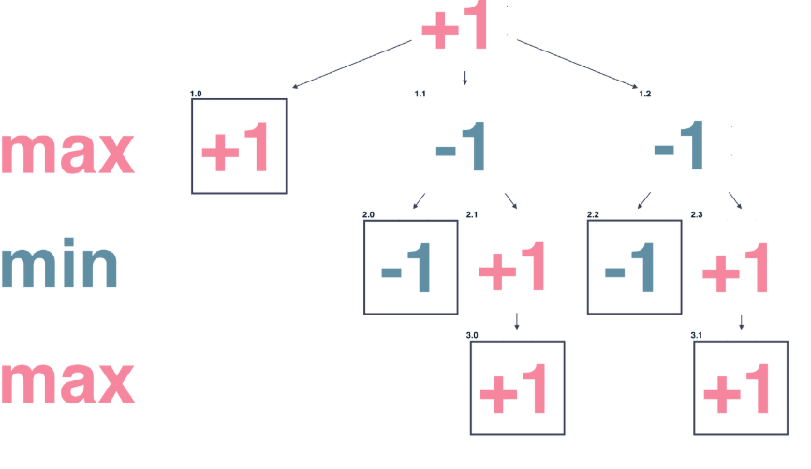
MinMax Example cont..
In a tree structure

Slide 10
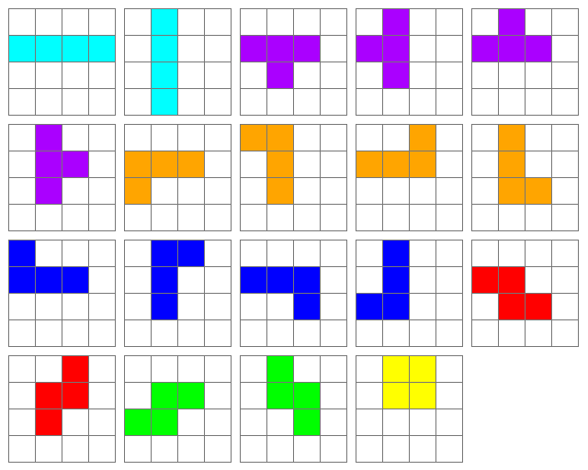
Will MinMax help to develop AI for Tetris?
Yes, but with lot of difficulties
Need to write a Min and Max evaluation function to decide Min and Max for given state of random piece
Becomes more like handcrafted Method
Difficult function to write and completely violates the purpose of the project

Slide 11
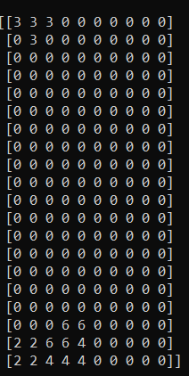
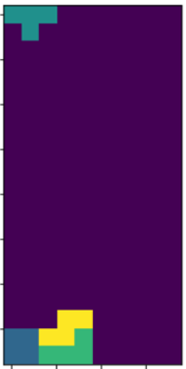
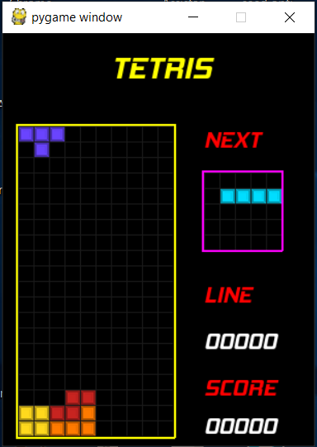

Let’s backtrack a little bit
Have close look at Tetris game state
Game Snapshot
Game matrix 20x10
plotted image

Slide 12
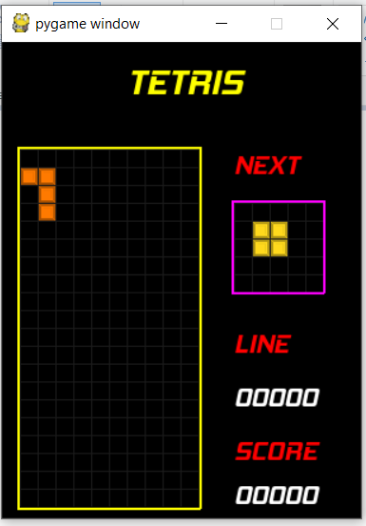

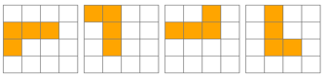
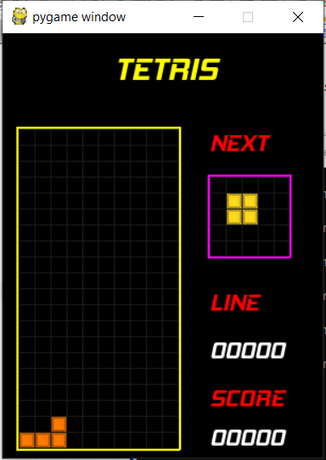
Let’s define the problem
Action
Rot = 2
Mov = 0

Slide 13
Let’s define the problem
Consolidate our observations
States of Tetris are looking more like image with different shape
Now we can classify this as image classification problem
Image classification is better done with Machine Learning
We use Neural Networks concept from Machine Learning
Let’s Understand Neural Networks

Slide 14
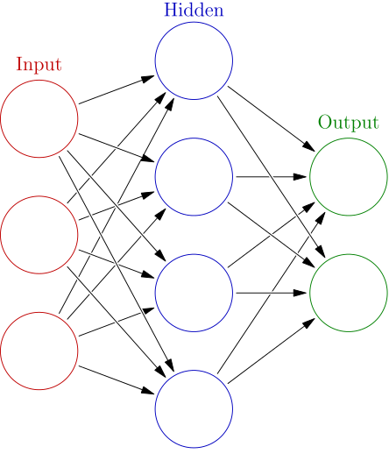
Introduction to Neural Network
A neural network is a network or circuit of neurons, or in a modern sense, an artificial neural network, composed of artificial neurons or nodes.^{[1]} Thus a neural network is either a biological neural network, made up of real biological neurons, or an artificial neural network, for solving artificial intelligence (AI) problems. The connections of the biological neuron are modeled as weights. A positive weight reflects an excitatory connection, while negative values mean inhibitory connections. All inputs are modified by a weight and summed. This activity is referred to as a linear combination. Finally, an activation function controls the amplitude of the output. For example, an acceptable range of output is usually between 0 and 1, or it could be −1 and 1.
14

Slide 15
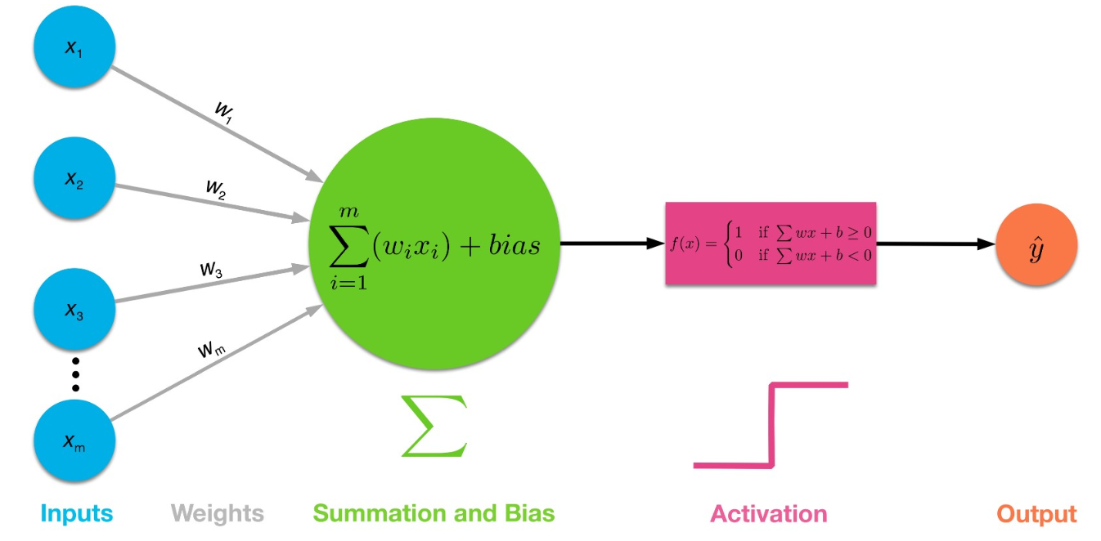
Introduction to Neural Network
Neuron/Perceptron
Neurons are the basic unit of a neural network
Properties of Neuron
Input
Weights
Activation
Output
Loss
15

Slide 16
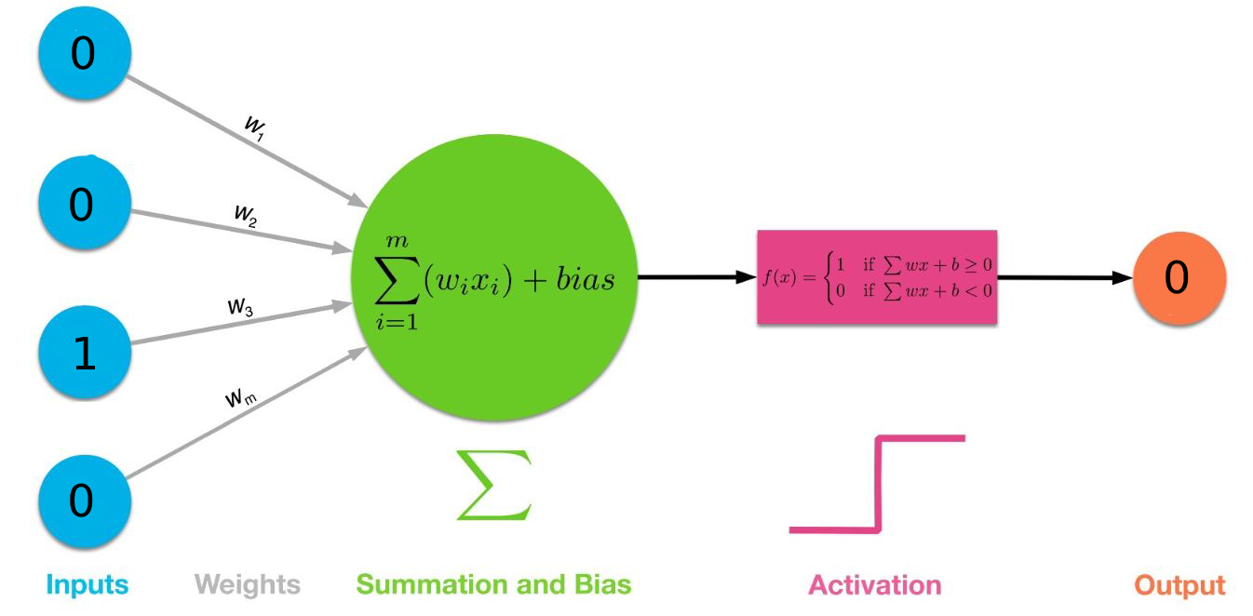
Small Example to understand Neural Network
Even or odd number guessing
Convert number to binary and pass it through input and verify output 1 if even or 0 if odd
Do it for 300 number and ask it to guess after 301 number
It guess more accurately if feed with more data

Slide 17
Simple Neural Networks or ANN
Challenges with Artificial Neural Network
the size of the our state image is 10*20, then the number of trainable parameters at the first hidden layer with just 4 neurons is 200. That’s huge
So We Choose Convolution Neural Networks (CNN)
Captures the spatial features from an image. Spatial features refer to the arrangement of pixels and the relationship between them in an image. They help us in identifying the object accurately, the location of an object, as well as its relation with other objects in an image
Helps to reduce the size of input

Slide 18
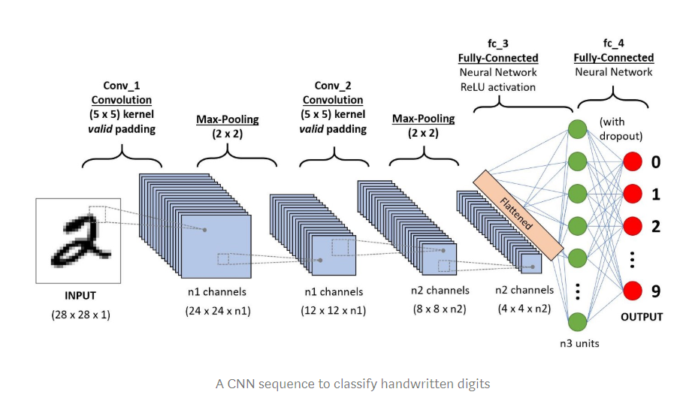
Convolutional neural network
Convolution neural network example to detect hand writing

Slide 19
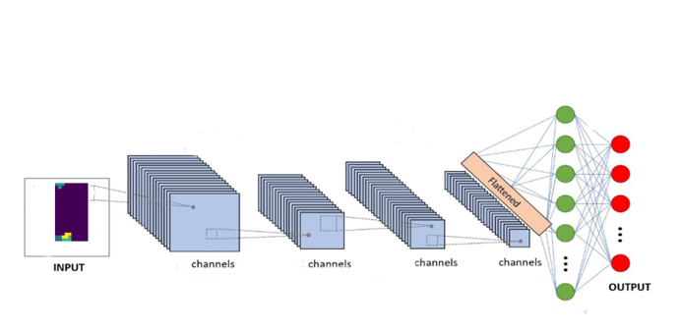
Try to use Tetris state image
Output/Label would be
Action
Rot = 2
Mov = 0

Slide 20

Input to CNN
Modify the game state 20x10 to 20x20 as CNN
works better if height and width of image is equal.
Copy the each symbol to particular location for better recognitions.
Save the state of Game array as NumPy array after every symbol land

Slide 21
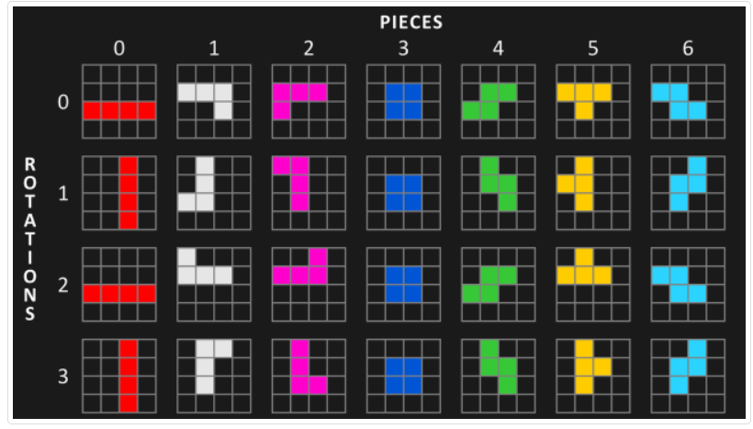
The Output / Label
Each symbol as 1 to 4 rotation
To avoid bugs we consider 4 rotation for all symbol
We have 10 location to place symbol as length of Tetris state array is 10 + 1 for symbol padding
So 4 x 11 = 44 actions

Slide 22
Formula for Output /Labelling
Action = (Mov) + (11*Rot)
We save each action after each symbol is placed in perfect location
Action
22
Rot = 2
Mov = 0

Slide 23
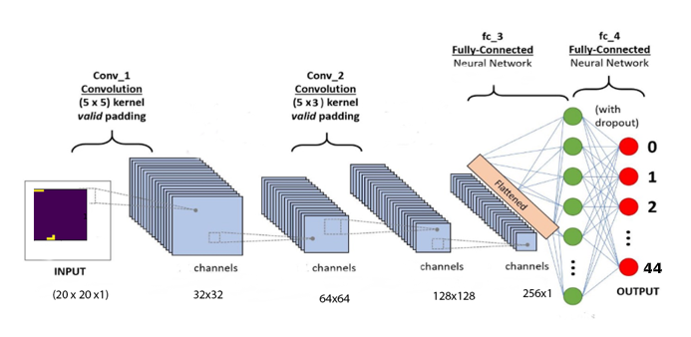
Our Model CNN
Output
Action
22
---------------
Rot = 22 / 11 = 1
Col = 22 % 11 = 0

Slide 24

Build CNN
Using TensorFlow a google Library
Model:
Convolutional layer input_shape=[20,20,1], filters=32, kernel_size=5, strides=5, activation=kf.nn.tanh,
Convolutional layer filters=64, kernel_size=3, strides=2, activation=kf.nn.tanh,
Convolutional layer filters=128, kernel_size=3, strides=1, activation=kf.nn.tanh,
Flatten
Dense units=512, activation=kf.nn.tanh,
Dense units=256, activation=kf.nn.tanh,
Dense units=44, activation=kf.nn.softmax
Optimizer: Adam with a learning rate of 0.005
Loss Function: Categorical Cross Entropy
Evaluation Metric: Accuracy

Slide 25
Create Dataset and Train the Model
Need game data with 100000 state NumPy array as input images
Generated Game exe with ability to serialize game state and action
Distribute the game among Altran BT team for game data
Wrote a program to convert save game data to dataset.
Train is fast on GPU ,but expensive
Can use google cloud with GPU option, still need to pay for GPU option
Train the data every day and save model. Best option , but time consuming
Once model is ready, Load the model in the game and pass same game state array and output will the action for that state

Slide 26
Demo

Slide 27
References
https://en.wikipedia.org/wiki/Tic-tac-toe
https://www.geeksforgeeks.org/minimax-algorithm-in-game-theory-set-1-introduction/
https://en.wikipedia.org/wiki/Tetris
http://news.mit.edu/2017/explained-neural-networks-deep-learning-0414
https://towardsdatascience.com/a-comprehensive-guide-to-convolutional-neural-networks-the-eli5-way-3bd2b1164a53
https://www.tensorflow.org/
https://pytorch.org/
https://www.youtube.com/watch?v=gZmobeGL0Yg&list=PLZbbT5o_s2xq7LwI2y8_QtvuXZedL6tQU
27

